Slide 1
QHD 201
Understand Healthcare Cost Complexities and How to be a Mindful Consumer
February 28, 2019
Presented by:
Kristin Parker, CEBS

Slide 2
Overview
Why is being a Consumer of Healthcare Important?
Resources for Making Choices
Medical Care
Prescription Drugs
Other Resources Available
How Optum Will Support You to Become a Better Healthcare Consumer – Dave Houston
Questions
Notes:
First, we’re going to briefly talk about why this topic is even important.
Then we’ll look at resources that are available to you – though Highmark and through other websites as well as other programs that you may already have access to without knowing it.
Dave from Optum will show you some resources for managing your HSA.

Slide 3
Why is being a Consumer of Healthcare Important?
The Healthcare Industry in the United States is in crisis. Healthcare Inflation (cost increase) has rapidly outpaced Overall Inflation and Earnings over the last 2 decades.
Source: Kaiser/HRET Employer Health Benefits, 2015 Annual Survey
Notes:
Chart by the renowned healthcare statistics group, Kaiser
Tracked the rates of increase over an 18 year period.
The Rapid increase in the cost of healthcare is why we have a healthcare crisis.

Slide 4
Why is being a Consumer of Healthcare Important?
As a nation, healthcare spending is substantial and growing.
Insurers have “attempted” to control cost.
Government has “attempted” to control cost.
Providers and prescription manufacturers treat us like Consumers (one of the fastest growing TV commercial segment)
For those of you in the QHD plan, the costs hit your pocket first, so you want to know what you are paying!
Notes:
I’m an optimist cynic – but I think it’s up to the American public to fix this problem!

Slide 5
Did you know?
Gettysburg College’s Highmark Insured Rates are a direct result of the healthcare usage of Gettysburg College members.
Notes:
If there is one new thing you learn today … this should be it (although I hope you learn more).

Slide 6
What can YOU do to help contain cost?

Slide 7
Preventive Care - Detect potential health risks early
Adult and childhood immunizations
Annual gynecological exams
Annual mammograms for women age 40+
Routine physicals
Select screenings
No cost-sharing when performed by a participating provider
Notes:
Avoid spending healthcare $$ by being healthy!!
For a complete list of preventive services covered by your plan, refer to your Highmark website.

Slide 8
General Prescription Drug Considerations
Choose generic drugs when possible
Choose 90-day Mail Order or 90-day Retail when possible
Ask about the full cost of the drug and what other options are available.

Slide 9
General Medical Plan Considerations
Where you use services is directly related to the cost
Telemedicine – Total Cost = about $50. Your copay is currently $15.
Highmark contracts with Amwell and Doctor on Demand – common services include:
Flu - Conjunctivitis - Sinus Infection - Sore Throat
Cough - Bronchitis - Upper respiratory infection
18 of the top 20 reasons people visit Urgent Care can be treated
Primary Care Physician – Total Cost = about $115
Specialist Physician – Total Cost = about $150-$200
Urgent Care Facility – Total Cost = about $200-$250
Emergency Room – Total Cost = about $1,500
Even within these categories – cost is not the same!
Urgent Care with a Hospital Network is 2x a standalone Urgent Care center.
Notes:
Telehealth usage – 12 telehealth visits in 2018. 5 dependents and 7 employees. 8 females, 4 males. Out of 1400 members.

Slide 10
TELEMEDICINE ACCESS
Register and download app to get started
Visit amwell.com or
Visit doctorondemand.com
US licensed, board-certified doctors. Can prescribe medications when appropriate.
Doctors available 24/7/365 on your device with video access.
No appointment necessary
Access from wherever you are

Slide 11
General Medical Plan Considerations
You can save hundreds of dollars a year simply by choosing where you get your care
Independent Labs – Centers that are not affiliated with a hospital and review your lab work (blood, biopsy, etc.) for your doctor’s office
Ambulatory Surgical Centers – Locations where doctors can perform same-day surgeries at a lower rate than hospitals
Value-Based Primary Care Physicians – Doctors who are paid to make sure you get and stay well, not by how many patients they see each day
Notes:
Review Slide
Remember . . .your renewal is based on your claims so if you make better choices it saves money for both you and the college.

Slide 12
How do you make Good Choices?

Slide 13
Highmark Website
Find a Doctor
Care Cost Estimator
Savings Advisor

Slide 14
Highmark Website
Login to your own, personal information
Coverage
Check eligibility and plan details
View Prescription History
View Benefit Plan Documents
Spending – Helpful for planning annual healthcare costs for FSA/HSA
EOBs (explanation of benefits)
Cost Saving Tools
Care Cost Estimator
Rx Cost Comparison
Prescriptions
View Prescription Claims
Notes:
Demo website
Zip = 17325
MRI of Brain with and without contrast
Compare

Slide 15
Other Website Resources
Pricing Websites (not necessarily recommended – sample list)
Amino.com/cost
Fairhealthconsumer.org
These simply give average cost for a service in the area. They are not tied to Highmark or give costs directly related to Highmark discounts.
Quality of Care
Lots of Websites
Some are based on member feedback (Highmark, healthgrades.com)
Some are based on federal statistics (carechex.com)
Notes:
Cost & Quality do not directly correlate.

Slide 16
Prescription Drug
There are a lot of good resources.
Highmark Website
Goodrx.com
Blinkhealth.com
Others
Notes:
Goodrx.com
Lipitor

Slide 17
Prescription Drug
Couponing
Online Website discounts
Most often cannot be used in conjunction with your health insurance.
Manufacturer discounts
Often used with health insurance to decrease the member’s copay.
Depending on your medication, insurance plan and the online discounts, it may be cheaper to get the prescription outside of the insurance.
This isn’t likely the case with Gettysburg College’s current plans, but may be with a QHD/HSA.

Slide 18
Other Resources
Gettysburg College’s Employee Assistance Program (EAP) Benefit
Through Wellspan
Many benefits to help with life
For example, access to 3 face-to-face sessions with experts (annually)
Grief
Drug and alcohol problems
Financial Difficulties
Mental Health/Family Counseling
Stress Management
The cost of this is fully paid for by Gettysburg College (no copays) and is not tied to the Medical Plan at all.

Slide 19
Other Resources
Memberships – You probably already belong to these!
AAA Membership
Prescriptions – Rite Aid, Walmart, etc. Up to 75% off retail price (average 26% off). Not combined with Health Insurance.
Vision coverage – 30% off eye exams, 15% off lenses and frames. Not combined with Vision Insurance.
Costco/Sam’s Membership
Vision Provider – Get exams and glasses (often discounted from stand alone vision providers).
Pharmacy
Can use insurance or not
Over the Counter prescription drugs are often discounted substantially
Often include Immunizations

Slide 20
Other Resources
Online Shopping (my search found these)
Vision especially
Zenni.com for glasses
1800contacts.com for contacts
Others?
Negotiating
Did you know that you can negotiate with your provider?
Not most of the time, but in some cases
Example – Physical Therapy

Slide 21
How Optum Will Support You to Become a Better Healthcare Consumer
Dave Houston, Optum Bank
2019
Notes:
[Presenter’s Note: Please review this document and update particular sections. In addition, you may find it’s easier to read the notes if you go to File/Send To/Microsoft Word, and choose “Notes on the bottom.”
Welcome.
Thank you for taking time out of your day to review how you can use your health savings account, or HSA, to help pay for your current qualified health care expenses and save for future health care expenses while saving on taxes.
My name is [XXXXXXXXXXX] and I represent Optum Financial Services. We are a financial services company dedicated exclusively to health care. We’re part of Optum, one of the nation’s largest health and wellness companies that serves 60 million individuals. Optum Financial Services also administers flexible spending accounts, or FSAs, health reimbursement accounts, transportation accounts and COBRA services. Our subsidiary, Optum Bank, offers the Health Savings Accounts.

Slide 22
What you need to know about your Health Savings Account (HSA)
You’re in charge of managing your HSA
Its an individually owned account, like your retirement account and IRA
Annual contribution limits are set by the IRS
Deposits can be made at any time and are available immediately
All deposits up to the annual IRS limit are income tax-free
Withdrawals made for qualified medical expenses are not subject to income tax
Investments are not FDIC insured, are not guaranteed by Optum Bank®, and may lose value.
Notes:
With an HSA, you’re in charge. And being in charge comes with some responsibility.
There’s no “claim” process like there is for HRAs and FSAs. You pay for qualified expenses directly from the account and are responsible for verifying the expense if the IRS requests it.
You’re responsible for administering how funds are used.
You decide when and how much to contribute.
You decide when you want to use your savings to pay for a qualified medical expense or to save your entire contribution so that it is available for you to use in the future.
You decide whether or not to invest some of your savings in mutual funds to increase potential long-term growth.
You also need to be aware of the annual contribution limits set by the IRS. The IRS dictates how much you can contribute to your HSA each year. I’ll review these limits shortly.
You also need to understand how to make deposits to your account and how to use your account to pay for qualified medical expenses. You can make a deposit to your account at any time, as long as you don’t exceed the annual limit. 100% of your contributions are available within a few days of depositing them.
Finally, you need to understand the tax advantages of an HSA. As I mentioned earlier, all contributions are tax deductible. You don’t pay federal income tax, and in most cases, state income tax on any HSA contributions. And, if you make your contributions through payroll deductions, you don’t pay FICA taxes either. This also allows you to reduce your taxable income. Your savings will grow tax-free and any interest earnings are not taxed. Also, withdrawals from an HSA are not subject to income tax as long as the funds are used for qualified medical expenses according to IRS guidelines. However, if you use your HSA to pay for non-qualified expenses, you will be taxed and assessed a penalty.
Now let’s talk about who is eligible to open and contribute to an HSA.

Slide 23
What you need to know about your Flexible Spending Arrangement (FSA)
Your Medical FSA contributions were made available 1/1/2019
Dependent Care FSA contributions are made available every pay period
Annual contribution limits are set by the IRS
All deposits up to the annual IRS limit are income tax-free
All withdrawals must be substantiated to satisfy IRS requirements
Investments are not FDIC insured, are not guaranteed by Optum Bank®, and may lose value.
Notes:
With an HSA, you’re in charge. And being in charge comes with some responsibility.
There’s no “claim” process like there is for HRAs and FSAs. You pay for qualified expenses directly from the account and are responsible for verifying the expense if the IRS requests it.
You’re responsible for administering how funds are used.
You decide when and how much to contribute.
You decide when you want to use your savings to pay for a qualified medical expense or to save your entire contribution so that it is available for you to use in the future.
You decide whether or not to invest some of your savings in mutual funds to increase potential long-term growth.
You also need to be aware of the annual contribution limits set by the IRS. The IRS dictates how much you can contribute to your HSA each year. I’ll review these limits shortly.
You also need to understand how to make deposits to your account and how to use your account to pay for qualified medical expenses. You can make a deposit to your account at any time, as long as you don’t exceed the annual limit. 100% of your contributions are available within a few days of depositing them.
Finally, you need to understand the tax advantages of an HSA. As I mentioned earlier, all contributions are tax deductible. You don’t pay federal income tax, and in most cases, state income tax on any HSA contributions. And, if you make your contributions through payroll deductions, you don’t pay FICA taxes either. This also allows you to reduce your taxable income. Your savings will grow tax-free and any interest earnings are not taxed. Also, withdrawals from an HSA are not subject to income tax as long as the funds are used for qualified medical expenses according to IRS guidelines. However, if you use your HSA to pay for non-qualified expenses, you will be taxed and assessed a penalty.
Now let’s talk about who is eligible to open and contribute to an HSA.

Slide 24
How to access your HSA and FSA funds
Use your Optum Bank® Debit MasterCard® and/or Use Apple/Android Pay
Sign up for automatic bill pay and online banking
Pay for an expense with personal funds and reimburse yourself from your HSA/FSA – credit card with rewards anyone?
Let’s review these options on the Optum Bank website
Notes:
While most of our account holders feel that the debit card is the easiest way to pay for health care expenses, there are a number of other ways you can use the funds. First, you can access your account to pay bills by signing up for automatic bill pay and online banking. This allows you to pay your bills online. You can also store the names and addresses of providers to make future payments more efficient, or you can even automate regular payments, such as to an orthodontist.
Another way to access your HSA is to order and use checks for your account. You can use these checks to pay medical bills. You can order HSA checks for $10 per book of 25 checks; you can also order checks from other establishments for your account.
If you’re looking to save for retirement, a great method is to pay for the expenses out of pocket. If you need the funds in the future, you can reimburse yourself for these later in the year, two years later, or even in retirement. Simply pay the bill with your regular credit card or check. When you need to be reimbursed, simply go online to use the reimbursement feature. Be sure to keep your receipts in case you are audited and the IRS requests documentation.

Slide 25
Save your receipts!
Save your receipts for all qualified medical expenses
Track bill pays, reimbursements and out-of-pocket expenses via expense journal
Optum Bank® does not track your expenses or verify eligibility on HSA transactions
Most FSA transactions won’t need a receipt, but keep it just in case.
Let’s review how this works on the Optum Bank website
Notes:
Here are a few tips that can help save you a lot of time and headaches later on! Always save your receipts for all qualified medical expenses, note whether the qualified expense was paid for out of your HSA, then retain the receipt for future reference. You can use a file folder, a shoebox, or save them online. Whatever method works for you. It is easy to to upload images of receipts online at optumbank.com and then store them within your HSA. You can easily organize and manage your receipts from your smart phone, tablet or desktop.
Remember, Optum Bank does not track or verify your spending. That is your responsibility. You do not need to provide receipts in order to reimburse yourself from the account, however you should always save your receipts for future reference in the case of an IRS audit.
Now let’s check in with Molly to see how she accesses her HSA.

Slide 26
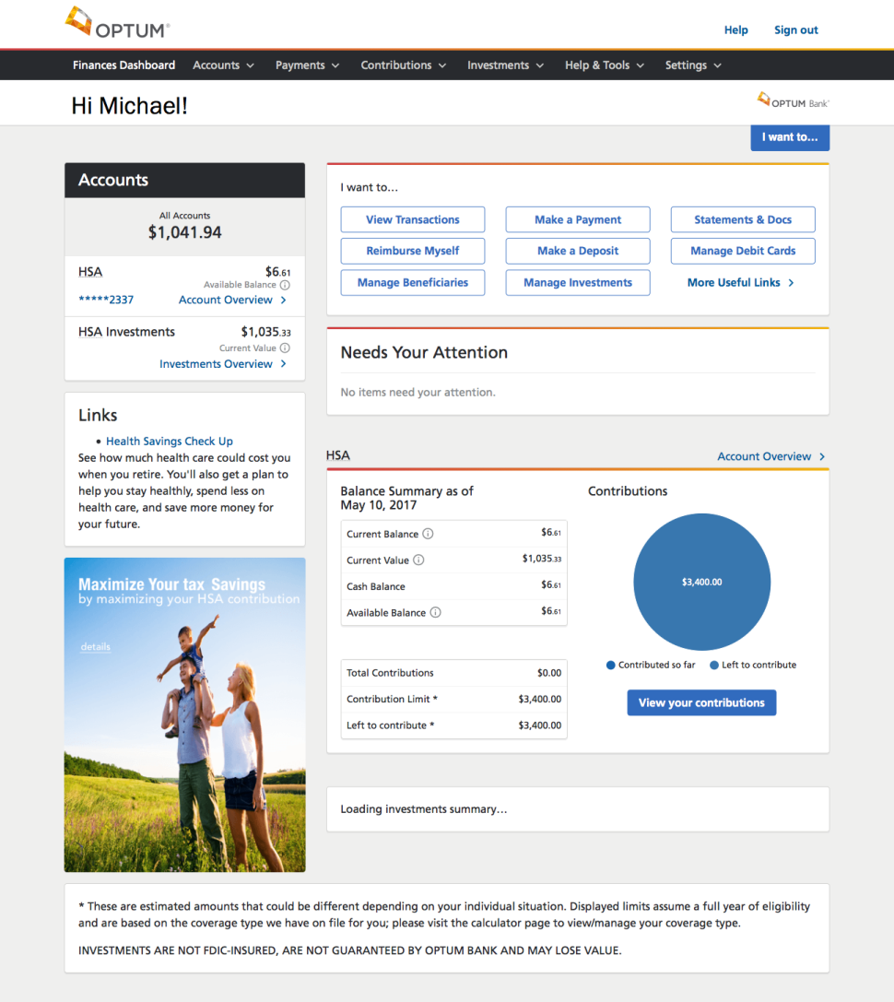
Managing your HSA and FSA online
See all your current balances at once in dashboard view
Reimburse yourself
Pay medical bills
Track bill pays, reimbursements and out-of-pocket expenses via expense journal
View, pay and store claims
Manage your contributions
Get answers to FAQs
Connect with customer support
Find forms and investment tools
Investments are not FDIC-insured, are not guaranteed by Optum Bank®, and may lose value.
Notes:
Optum Bank has created an easy-to-use web site for health savings account holders. You’ll find resources to help you learn about HSAs, as well as access HSA calculators to help you determine your annual contribution and potential tax savings.
There are many things that you can do from our website. You can make a contribution to your HSA at any time by arranging a one time or recurring deposit from another banking account.
If your provider does not accept Mastercard, you can pay health care providers through our online bill pay feature. Or, if you have paid for a qualified medical expense out-of-pocket, it is easy to reimburse yourself online. And it is easy to upload receipts to your HSA and keep track of them online.
You will also have access to our contribution tracker, which shows you how much you have contributed to your HSA year to date and shows you how much you are eligible to contribute based on your plan type (individual or family).
Another great feature of the Optum Bank HSA is the ability to invest a portion of your HSA dollars into mutual funds, once your account reaches a designated threshold (typically $2,000). Keep in mind, though, that while deposits are insured by the FDIC up to $250,000, investments are not FDIC insured, are not guaranteed by Optum Bank, and may lose value.
However you choose to manage your account, it is easy to do online from your smart phone, tablet or desktop.

Slide 27
Making your Health Savings Account work best
Use your HSA funds now, or save for the future
Use the funds in your HSA as you need them
Build balances to cover your current and future healthcare costs
Save for the future and grow funds tax-free
Let’s review how this looks on the Optum Bank website
Notes:
Remember that you can use your HSA funds now or save them for the future.
You can use the funds in your HSA as soon as they are deposited.
An HSA is a special savings account that works the same way as a traditional savings account at a bank.
You can withdraw or use all or part of your account balance at any time for qualified medical expenses.
You can build up your balance to cover your HDHP deductible.
You do this through a one-time deposit or through regular recurring deposits, such as ongoing payroll deductions.
You can also build up your balance by setting aside the difference between what you would have paid for traditional premiums and your current HDHP premium.
Finally, you can use your HSA to build your health care savings for the future.
You do this by paying for your health care expenses out of pocket.
This way, you can delay making HSA withdrawals and your HSA balance will continue to grow tax-free.
There’s no time limit on reimbursements so be sure to save your receipts. This way you can be reimbursed at a later date for any expenses that you incur today.
Now let’s look at some of the ways you can maximize your HSA balance.

Slide 28
How to make deposits into your Health Savings Account
Payroll deduction
Contribute via payroll deductions at Gettysburg College and save on FICA taxes. This is the easiest way to save! You can change your contribution throughout the year.
Contribute online
Arrange a one time or recurring electronic transfer from an account at another financial institution.
Mail a check
Deposit additional dollars into your account by mailing in a check.
You can make HSA deposits until April 15th in order to realize tax savings for the prior year
Notes:
You can make deposits to your HSA at any time during the year. There are several contribution methods you may want to consider.
First, if your employer offers payroll deduction contribution, you can chose to deduct a set amount from each paycheck to help build your balance automatically. Payroll deduction also offers increased tax savings of 7.65% from FICA taxes.
Second, you are free to add more to your HSA using after-tax income. You can set up a one time or recurring deposit to your account online. Or, you can always mail in a check. Any after-tax deposits will be listed on your tax return as a below the line tax deduction.
You will also want to keep in mind that you can make a contribution for the preceding tax year until April 15 to reap the tax benefits for the prior year. This is another way in which an HSA is similar to an IRA.

Slide 29
Contribution limits for your Health Savings Account
Amount of contribution
The IRS determines how much you can deposit into your Health Savings Account each year.
Contribution rules
In 2019, contribution limits are $3,500 for individual coverage and up to $7,000 for family coverage. This includes contributions from Gettysburg College.
Additional contribution
Those 55 years of age or higher, but not yet enrolled in Medicare, can fund an additional $1,000/year “catch-up” contribution.
Notes:
As I mentioned earlier, the IRS determines the maximum amount you can contribute to an HSA every year.
In 2017, you can contribute up to $3,400 if you sign up for the health care plan as an individual. If you sign up as a family or individual +1, the contribution limit goes up to $6,750. In 2018, you can contribute up to $3,450 for individual coverage and $6,900 for family coverage. The IRS allows people nearing retirement age to make additional “catch-up” contributions to help build balances to be used to help pay for health care costs during retirement.
You can contribute an additional $1,000 a year if you are 55 years or older.
If both you and your spouse are 55 or older, you can both contribute an additional $1,000. Your spouse will need to open his/her own HSA to make his/her own HSA catch-up contribution.
You are not eligible to make “catch-up” contributions if you are receiving Medicare benefits.
You can learn more about contribution limits and making catch-up contributions by going to irs.gov.
Now let’s learn how an individual might use an HSA to pay for health care costs and save on taxes.

Slide 30
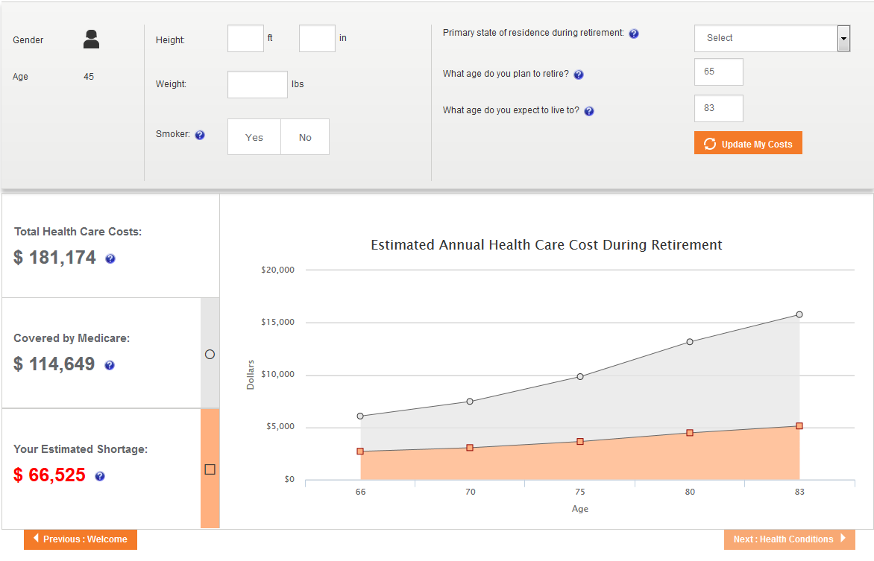
Healthcare Cost During Retirement
The Health Savings Checkup is an interactive, engaging tool for account holders to easily see the effects small changes can make to their financial and retirement health.
Step 1: The account holder enters basic information about his life, health situation, spouse or partner, as well as estimations for future health issues.
Step 2: In real time, the account holder receives estimated health care costs and an assessment of retirement readiness based on Optum’s proprietary analytics.
Better estimate your health care costs in retirement.
Notes:
Health savings check-up allows the user to estimate their health care costs in retirement be entering in information about their life, health situation, spouse/partner information, as well as estimations for future health issues. The number generated shows how much their health care costs would be, how much is covered by Medicare/their HSA, and how much their estimated shortage would be.
Enhanced graphics make this experience more intuitive and informative for the user- and in the end makes is simple to estimate health care costs over a lifetime and through retirement. Our Health Savings Checkup online tool allows the user to estimate the health care dollars they’ll need in retirement. It delivers an important message about saving for out-of-pocket costs now and in the future.
People love the engaging and interactive nature of the Health Savings Checkup, and this is an Optum differentiator that none of our competitors have.

Slide 31
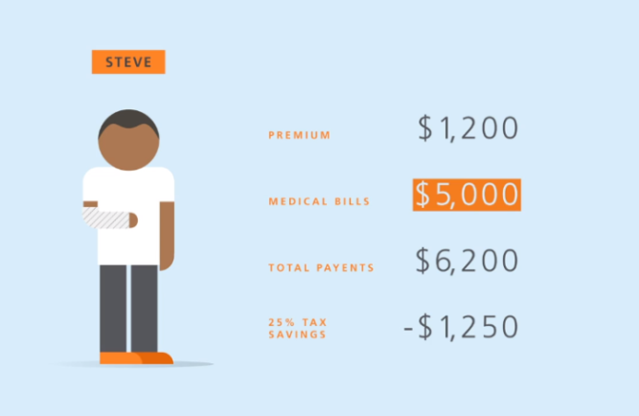
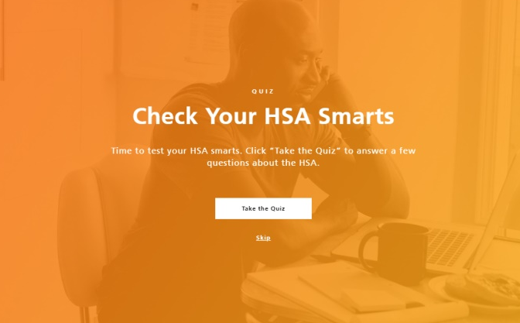
Optum Bank Academy
Created with the objective of educating members and empowering them to become better consumers of healthcare. Optum Bank Academy meets consumers where they are in their HSA journey, by tailoring content to various life and healthcare spending stages.
Each course includes:
Engaging video content
Illustrative examples
Knowledge checks
Consumer Polls
Downloadable PDFs for take-and-go learning
Notes:
Health savings check-up allows the user to estimate their health care costs in retirement be entering in information about their life, health situation, spouse/partner information, as well as estimations for future health issues. The number generated shows how much their health care costs would be, how much is covered by Medicare/their HSA, and how much their estimated shortage would be.
Enhanced graphics make this experience more intuitive and informative for the user- and in the end makes is simple to estimate health care costs over a lifetime and through retirement. Our Health Savings Checkup online tool allows the user to estimate the health care dollars they’ll need in retirement. It delivers an important message about saving for out-of-pocket costs now and in the future.
People love the engaging and interactive nature of the Health Savings Checkup, and this is an Optum differentiator that none of our competitors have.

Slide 32
What if you have more questions?
If you enroll in the Qualified Plan with the Health Savings Account you will have future opportunities to learn more
Call Optum Bank customer service (866) 234-8913
Visit optumbank.com and download the Optum Bank Mobile App
Talk to your Gettysburg College HR Team
Notes:
If you have questions about your HSA, you can call the toll-free customer service number listed on the back of your debit card. You can also visit optumbank.com. The web site contains lots of easy-to-use information, frequently-asked questions and tools to help you better understand your HSA. Or, you can talk to your employer.

Slide 33
QUESTIONS?

